Slide 1
Computational Systems Biology for Medical Applications Summary of Approach to Modeling Game
Joseph L. Hellerstein*
*eScience Institute, Computer Science & Engineering

Slide 2
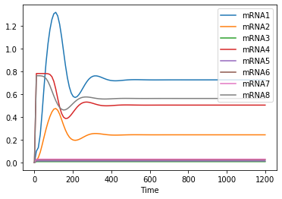
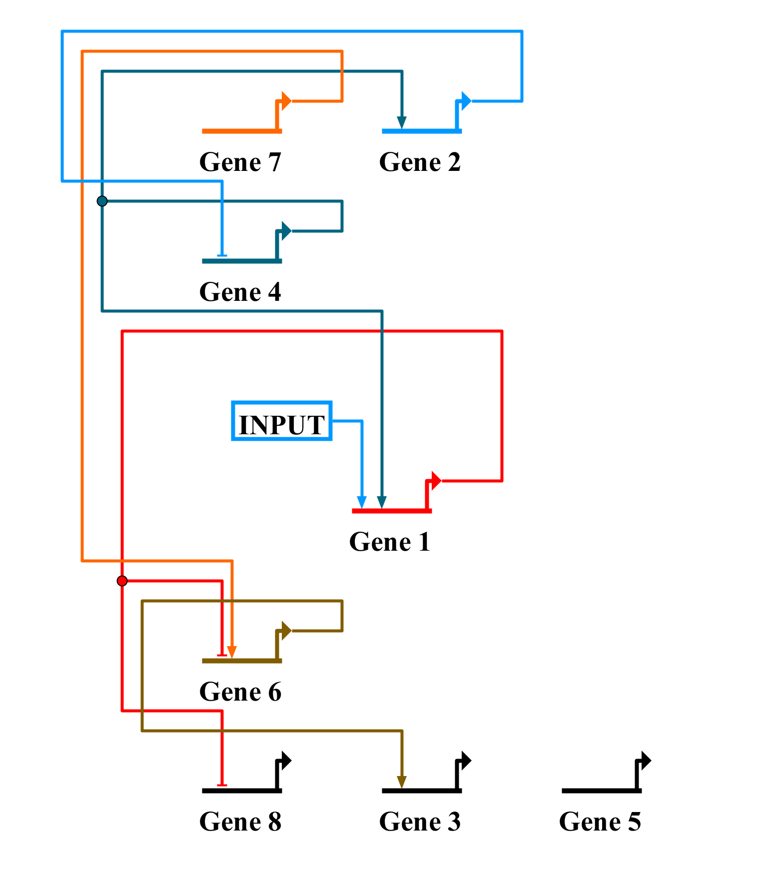
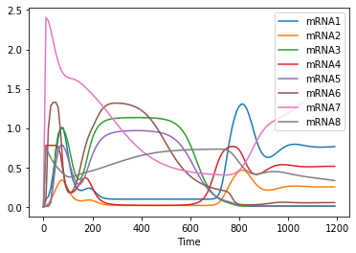
Modeling Game
Simulation of Base Model
mRNA Measurements

Slide 3
Objective
Discover the modeling game GRN using only:
wild type mRNA data (no protein data; no knockouts)
laptop (no supercomputer)
Dual problem
Use protein data instead of mRNA

Slide 4
Challenges
Combinatorics
Coupled kinetics mean multiplicative combinatorics
Computation time due to
number of parameters to estimate
length of time to simulate
Gene | TF Combinations
1 | 0
2 | 15
3 | 15
4 | 15
5 | (16)(15) = 240
6 | 0
7 | (16)(15) = 240
8 | 15
TOTAL | (15⁴)(240²) ~ 2.5B
Brute force search is impossible, even with a supercomputer.
Notes:
15 possibilities since 7 genes, either activate or inhibit, and there is a possibility that there is no second TF.

Slide 5
Core Idea: Decouple Kinetics Equations
J1: => mRNA1; L1 + Vm1*((K1_1*INPUT^H1 + K2_1*P4^H1 + K1_1*K3_1*INPUT^H1*P4^H1)/(1 + K1_1*INPUT^H1 + K2_1*P4^H1 + K1_1*K3_1*INPUT^H1*P4^H1)) - d_mRNA1*mRNA1;
J4: => mRNA4; L4 + Vm4*(1/(1 + K1_4*P2^H4)) - d_mRNA4*mRNA4;
F4: => P4; a_protein4*mRNA4 - d_protein4*P4;
Ex of couplings
J1 is coupled with F4 because J1 depends on P4
F4 is coupled with J4 because F4 depends on mRNA4
Decouple by
Using mRNA observational data for the mRNA values
eliminates F-to-J coupling
Producing estimated protein data using “F” reactions
eliminates J-to-F couplings

Slide 6
Benefits of Decoupling
Greatly reduce combinatorics of the networks to evaluate
From 2.5B to 540
Can analyze time segments of dynamics
Gene | Combinations
1 | 0
2 | 15
3 | 15
4 | 15
5 | (16)(15) = 240
6 | 0
7 | (16)(15) = 240
8 | 15
TOTAL | (4)(15) + (2)(240) = 540

Slide 7
Workflow
Estimate proteins from observations of mRNA
Use “F” reactions.
For each gene
Construct hypotheses for which proteins are transcription factors
Evaluate hypotheses using numerical integration using the mRNA observations and estimated protein data
Select the best set of transcription factors and record the parameter estimates
Incorporate the above kinetics into the Tellurium simulation.
Use the above parameter estimates as a starting point for a full optimization of the simulation model.

Slide 8
Hypothesizing Gene Interactions
Guessing from the dynamics didn’t work for me.
Much better results if construct hypotheses from cross correlation matrix.

Slide 9
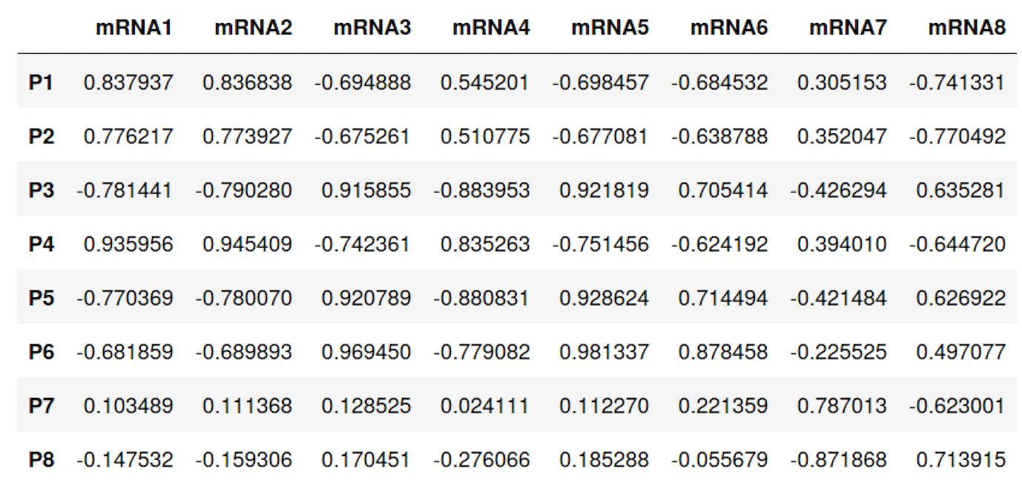
Cross Correlations

Slide 10
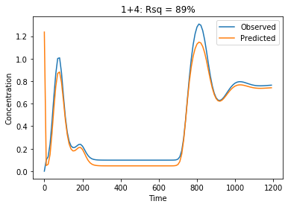
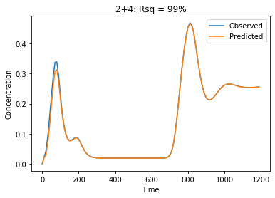
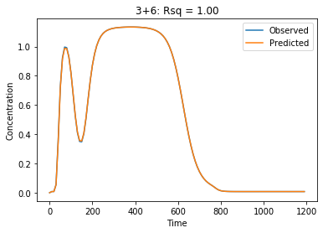
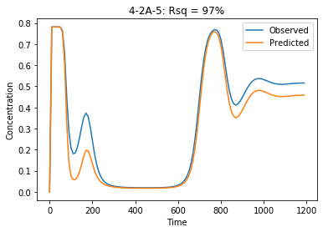
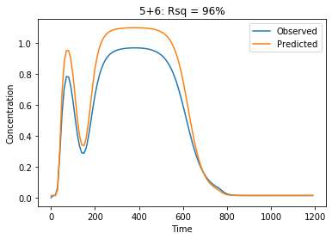
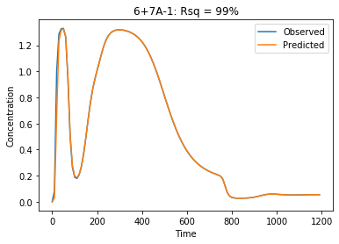
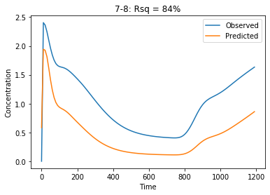
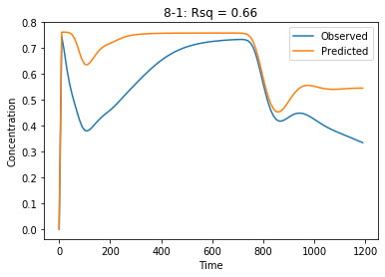
Model Results by Gene
1
2
3
4
5
6
7
8

Slide 11
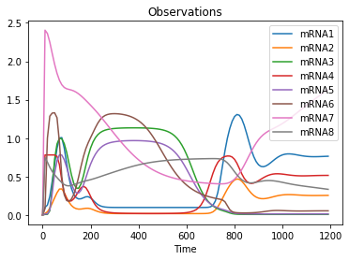
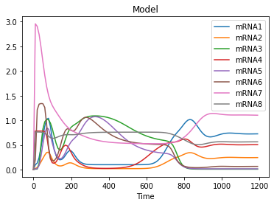
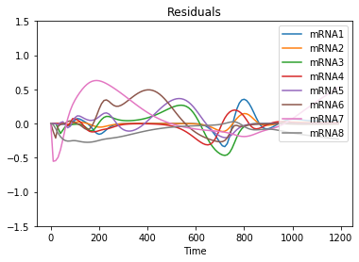
Model Performance

Slide 12
Changes to Initial Model
2 and 5 repress 4
6 activates 5
8 represses 7

Slide 13
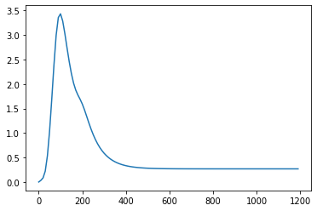
Stress Test
Without Perturbation
With Perturbation
X

Slide 14
Lessons
Need an overall strategy to address the huge combinatorics
My strategy: decouple the kinetics equations
Need good control over parameter optimization
Choice of objective function (used 1 – R²)
Limits on number of iterations
Visualize the data.
Model quality metrics often fail to yield good models.
Don’t skimp on computational tools.
I spent much less time analyzing models than I spent writing software so that I could more rapidly analyze models
Limitations on accuracy without knockouts and stress tests
Do more with model search

